Slide 1

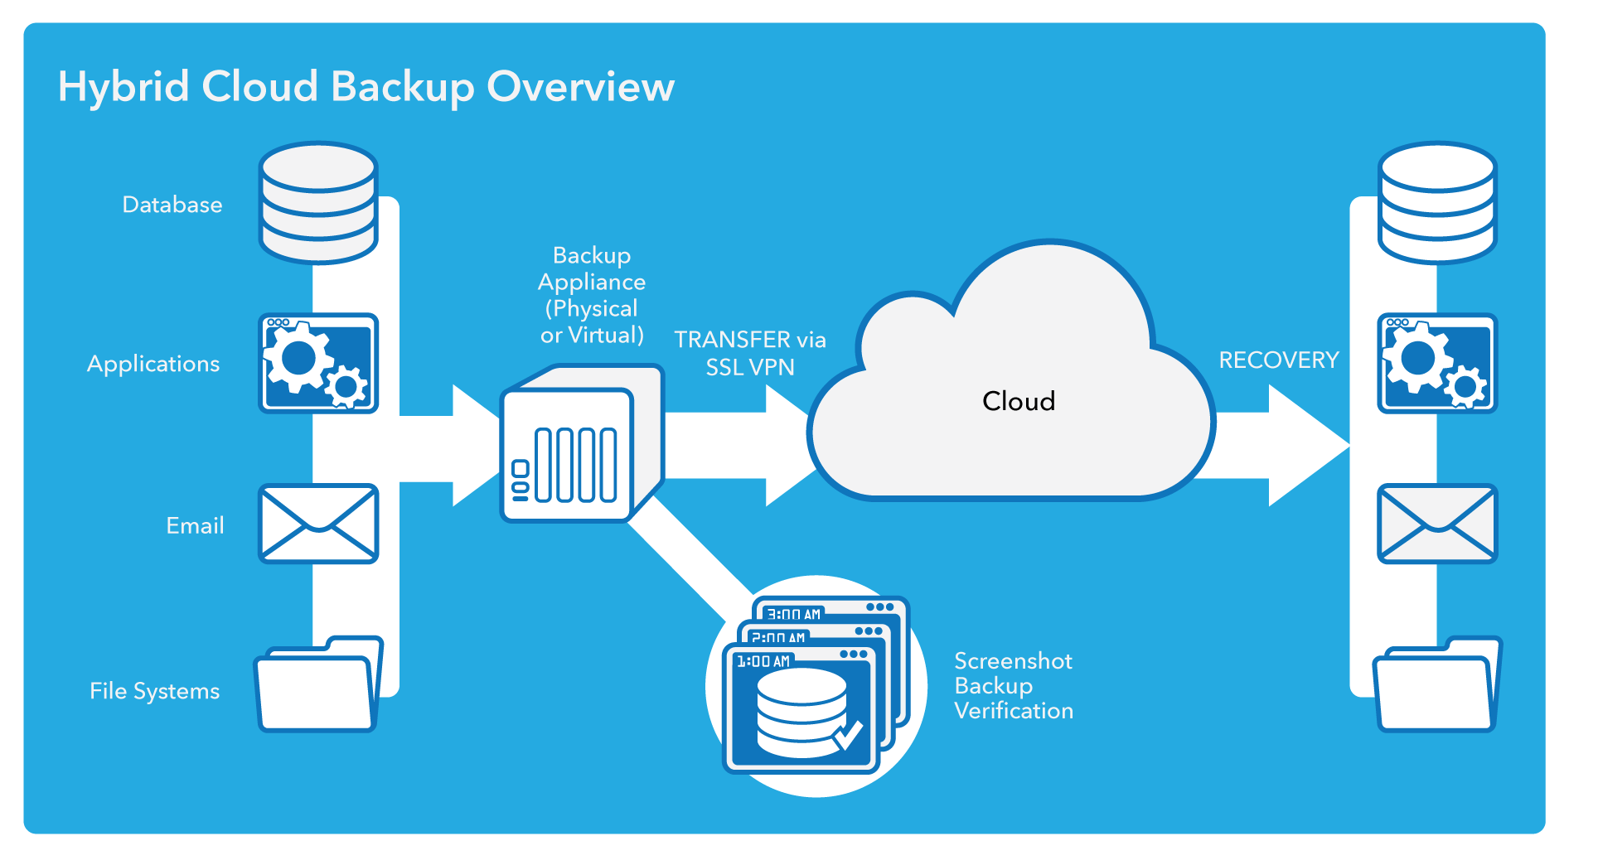
How SMBs Benefit with Hybrid Cloud
Essential for Secure Backup and Business Continuity
Today’s businesses require a backup solution that delivers much more than a traditional local only strategy. Given the constant risks to its data, from all directions, it’s important for businesses to ensure 1) that their data is protected and
2) they can remain operational in lieu of a system disruption. That’s where a hybrid cloud-based backup solution comes in.
According to analyst firm ESG hybrid architectures are the top desired features by today’s businesses.* With good reason.
This paper identifies four key reasons why a backup, recovery and business continuity solution based on a hybrid cloud model is preferred.

Slide 2


1. Security
With a hybrid solution, a company’s essential data is backed up locally and then an additional backup is replicated off-site, providing additional data security; data insurance if you will. The in-house data is protected by redundant sets of information with the local device being the first line of defense. In most cases, three distinct copies of each file exist – on the workstation or server, on the local device and in the public cloud.
In addition, encrypted files are stored off-site are available in case
an unforeseen event, like a natural disaster, occurs. This should give businesses the peace of mind to know that their data is always accessible no matter what the circumstances. With this model, MSPs and VARs have multiple sources to assist clients in data protection, and can emphasize that it is just as important to insure data as it is to insure physical resources, like buildings, employees and other assets. After all, client data is a business’ most important asset, and ensuring business continuity in the form of hybrid cloud storage is an intelligent and logical step toward protecting that asset.
2. Storage
Businesses also benefit from local storage flexibility, addressing a key concern that many small companies have, with a hybrid cloud solution. Since cloud storage is far less expensive, businesses can retain more data on the cloud and have a shorter retention locally. Small businesses are often concerned about space on local storage devices, and the cloud gives them the chance to make decisions about how long to store backups on their local devices. Businesses no longer have to worry about purchasing more local storage, nor do they have to make difficult choices about
what files to delete when they are running out of space. Once again, it
is important to emphasize the peace of mind that this option provides for businesses. It eliminates a pain point for companies that have struggled with limited resources dedicated to storage. Their files are available for as long as they need, and they can be easily restored when necessary. These businesses can cease worrying about storage and turn their attention to their core competencies, confident that their data is secure and available.

Slide 3

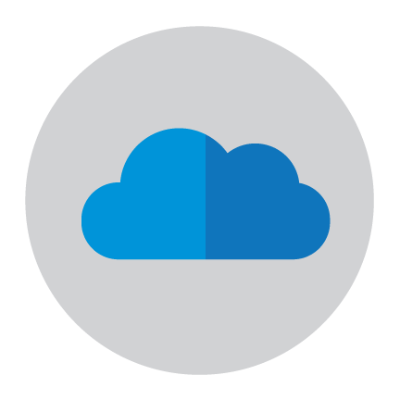
3. Savings
One of the biggest concerns for SMBs when making any sort of technology decision is the bottom line. Fortunately, hybrid cloud backup solutions are cost effective. The hybrid model keeps costs low. Because companies
only need to purchase a local unit while the rest of the infrastructure lies in the cloud. The cost to businesses is a simple monthly fee that covers the cost of leveraging the cloud and all of the services outlined in the SLA. It’s important for businesses to look for a solutions provider that can offer fixed cloud pricing.
4. Virtualization
In the event of a disaster, be it natural or technical, businesses must be confident that their data was backed up, and that it can be restored in a timely manner. When SMBs experience downtime, they stand to lose a great deal of money as IT strives to bring operations back online. In these instances, virtual machines (VM) can be the difference between downtime and uptime. VMs are copies of workstations or servers running on a server in the cloud. Every aspect of the duplicated machine can be run from this virtual machine that lives in the cloud, and is therefore not vulnerable to localized phenomena, like a weather disaster. Companies can failover
to the cloud to avoid downtime, keeping data and operations running smoothly and consistently, ensuring business continuity even when the winds are strong and the weather fierce.
Hybrid cloud backup solutions offer businesses the best of both worlds, and play an essential part of a comprehensive backup, recovery and business continuity strategy. The added benefits of Security, Storage, Savings and Virtualization should make the transition to a hybrid cloud solution a little easier, and hopefully alleviate any fears of the cloud.
To learn more contact DATALINK NETWORKS: 1-877-487-3783.
*ESG, Data Protection Appliances Survey, 2015

